Slide 1


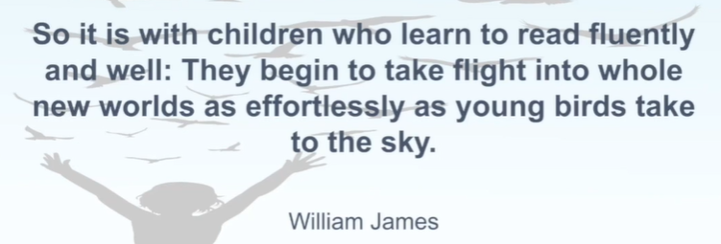
Phonics Workshop
Monday, 10th October 2022

Slide 2
Our most recent Ofsted report (26th April 2022) said:
“Leaders have prioritised the teaching of reading. They help children to develop their understanding of the sounds that letters represent from their very first days in early years. Staff provide effective support for children and pupils who are at the early stages of learning to read. Staff pay close attention to those who struggle and provide extra help to ensure that they keep up with their peers. Staff have been well trained to deliver the school’s new phonics programme. They are using the programme effectively to help pupils to develop into accurate and fluent readers. They ensure that the books pupils read are well matched to the sounds that they know. Pupils said that they enjoy reading. Older pupils read regularly and have a broad knowledge of different authors and genres.”

Slide 3
Key Principles of Phonics
Throughout this presentation we’ll look at:
Which scheme we are using
What it looks like throughout the school
Reading sessions
How you can support your child at home
How we measure impact/ progress
Key terminology

Slide 4
Our Phonics Scheme
Little Wandle
Daily phonics lesson delivered in FS/ Y1 and to those who did not pass the screening check in Y2 and beyond (KS2) using this programme
We adopted the scheme at the beginning of Autumn 2 2021
Shared reading sessions take place 3x a week for those children using the LW scheme in FS/KS1
Children are allocated one phonetically decodable book per week. These are Big Cat Collins books that have been specifically written for the LW scheme
In addition to this, the remaining books in school (LW/ORT) have been audited and re banded. These are being used as shared reading texts for the children- these can be changed as many times as the child likes throughout the week. All reading (home/school) is recorded on Boom Reader (formerly Go Read).

Slide 5
Why we teach Phonics
We have one, very simple aim:
To get the children reading fluently as quickly as possible!
Being able to read opens up the curriculum for all children- it really is the gateway to learning.

Slide 6
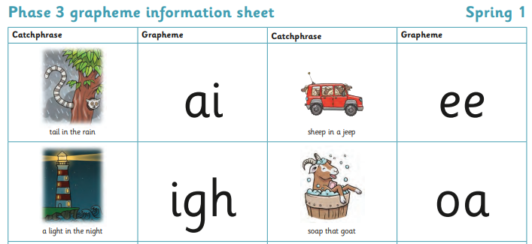
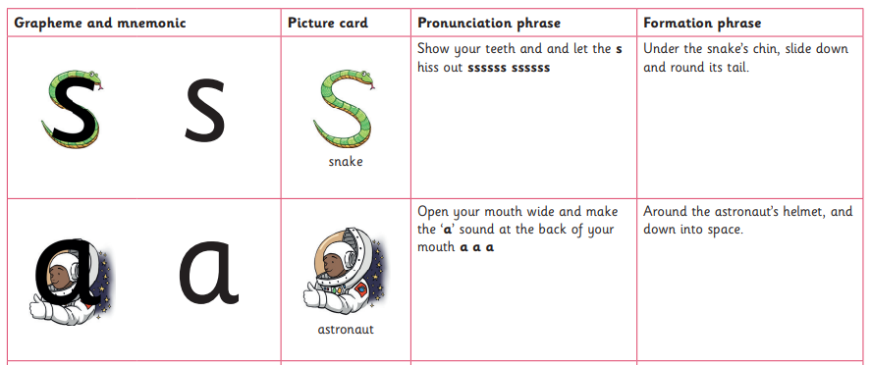
What phonics looks like throughout the school
Phonics lessons are consistent throughout the school
A mastery approach to whole class teaching has been adopted
Flashcards and wordcards are used
Formation, pronunciation phrases and catchphrases for each grapheme

Slide 7
Tricky Words
The expectation has been raised with tricky words- a lot have been moved down into the previous phases. Tricky words are simply words that cannot be sounded out. Within phonic lessons, children are taught to both read and spell tricky words within the phase that they are working on.
the
is
when

Slide 8
Little Wandle Reading Sessions
Little Wandle reading sessions take place 3 times a week
The children are grouped according to ability in groups no larger than 6
They read with a familiar adult and this is recorded via Boom reader
The 3 sessions follow the same pattern each week.
Session 1-Decoding
Session 2- Prosody
Session 3- Comprehension

Slide 9
Reading Sessions
Decoding: The children will look through the tricky words and any new vocabulary. They will have the opportunity to read the book to decode the words.
Prosody: In this session the children will read the book again, but now that the text is becoming more familiar the focus will be on reading with expression and intonation.
Comprehension: The children will be asked questions about what they have read in the text. These may be literal questions (where the answer is in the text) or inferential (when the answer isn’t in the text- they may be asked to use evidence from the text to support their answer).
Reading books will then be sent home after the third session and children will keep them for a week
By this point, children should be reading at 90% fluency so they should be able to read 9 out of 10 words quickly and be confident to share the book with you.

Slide 10
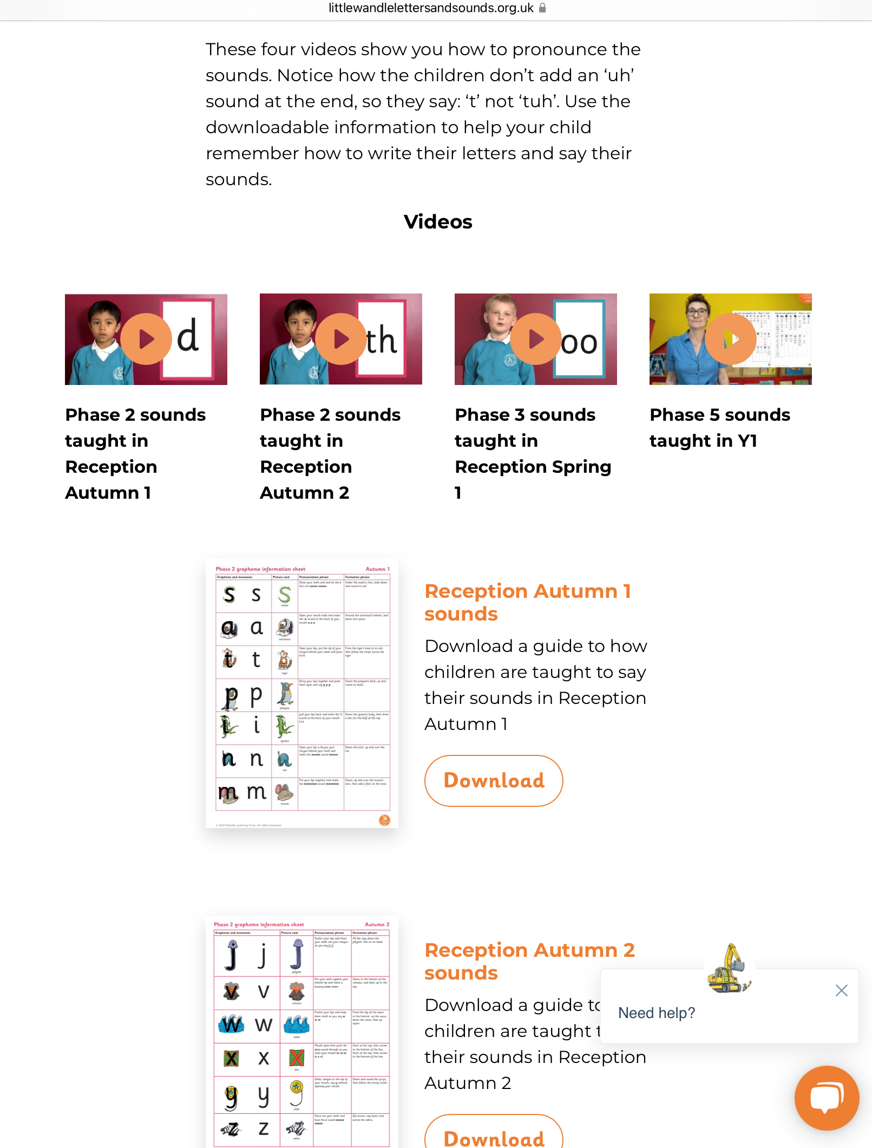
Parent Resources
The website contains a wealth of information to support parents.
You can view videos on pronunciation, you can see what a lesson looks like and overviews for each year group are also on there- broken down into half termly sections.
https://www.littlewandlelettersandsounds.org.uk/resources/for-parents/

Slide 11
How we measure impact/ progress
All children completed a ‘Placement Assessment’ which gave us a baseline for where their secure phonics knowledge was at the beginning of Reception.
Formative assessment is used within daily lessons to identify those who haven’t grasped the concept of that day’s focus- there is then a ‘same day intervention’ referred to as ‘keep up sessions’.
Summative assessments are completed half termly and a clear tracking grid is used to show individual children’s progress. A copy of the individual assessments will be sent home with your child so that you can see where your child is working at.

Slide 12
Key terminology
Phoneme- the smallest unit of sound within a word. There are 44 phonemes in the English language.
Grapheme- the letter or letters that are used to spell the phoneme. Alternative graphemes are also used e.g. ai, a_e, ay,a
Digraph- 2 letters that make one sound e.g. sh, wh, ea, ar, ey
Trigraph- 3 letters that make one sound e.g. ear, igh, air
Grapheme phoneme correspondence (GPC)- matching both the phoneme and grapheme together. This allows children to blend words both written and orally. This also helps to develop the children’s spelling skills as they can segment the words into phonemes that they can hear before writing it down.

Slide 13

Any questions?

