Slide 1


Welcome to Cranberry Academy

Slide 2





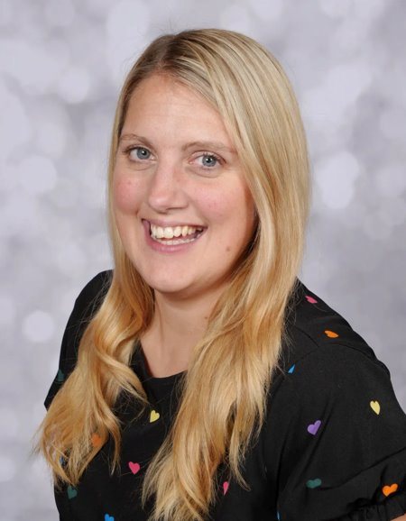
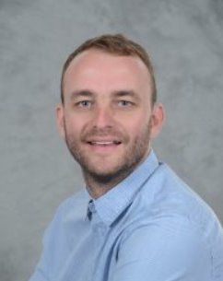
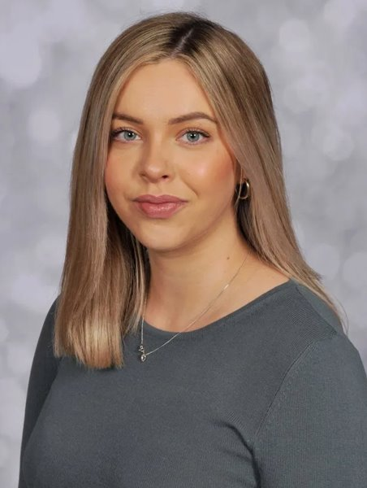
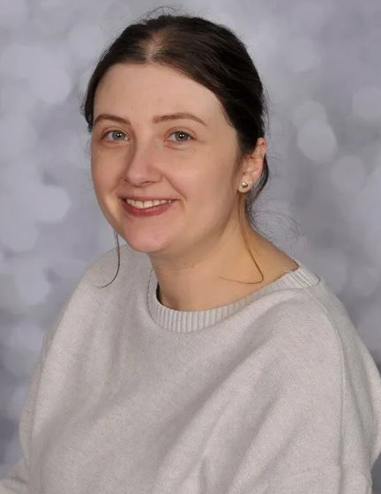
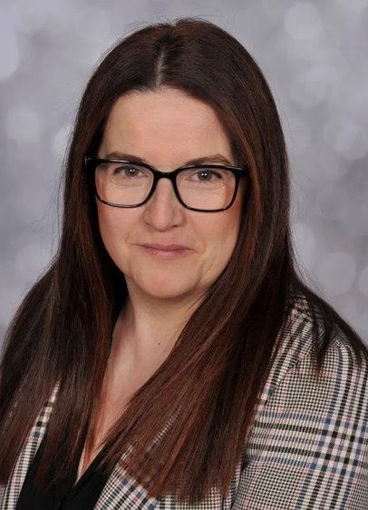
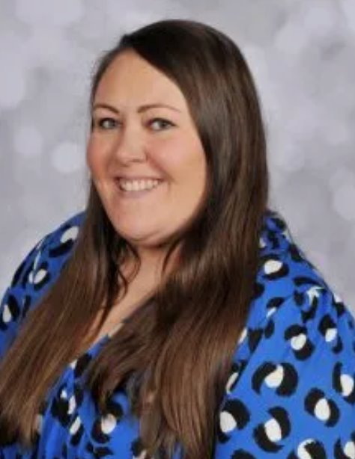
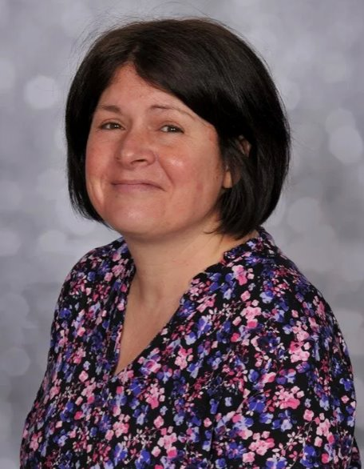
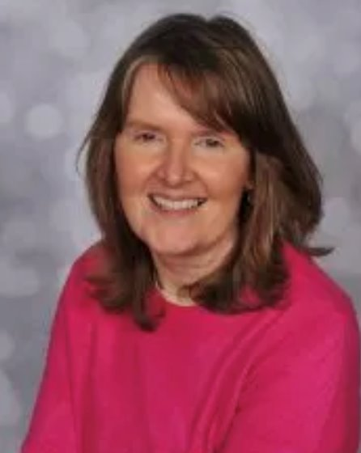
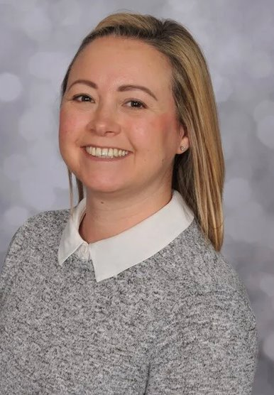
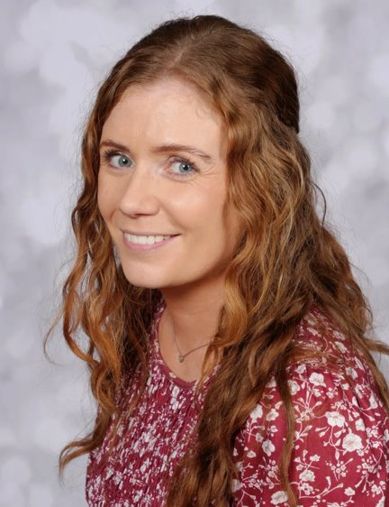
Meet the staff…
Senior Leaders
Nursery
Reception
Mrs Grindley
Teacher
Miss Lock
Teacher
Mrs Podmore
EYFS lead/Teacher
Miss Goodwin
Teacher
Mrs Smith
Principal
Mr Suddaby
SENCO
Mrs Manifold
Teaching Assistant
Miss Newell
Teaching assistant
Miss Cleverton
Teaching assistant
Mrs Minshull
Apprentice

Slide 3

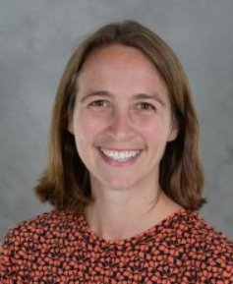
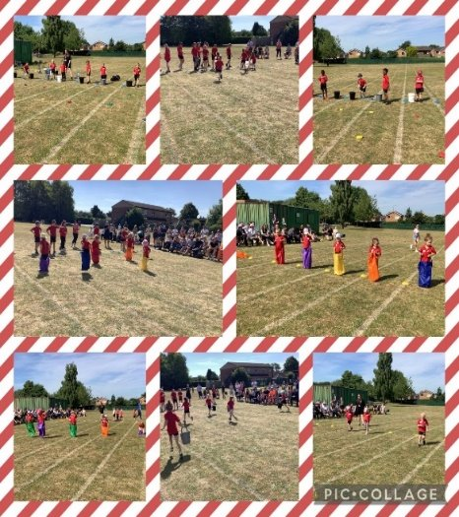


Other staff!
Mr Tinsley
PE specialist
Mrs Hollomby
Outdoor Learning specialist
Miss Newell
Mental Health & Well-being specialist
Miss Cleverton
Teaching assistant
Miss Cleverton
Teaching assistant

Slide 4
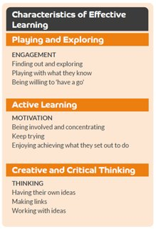
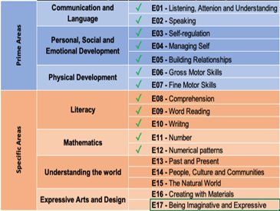
The Early Years Foundation Stage Curriculum!

Slide 5
Admission Arrangements
(Any children who want a place in reception need to re-apply before December 2025. Admission to Nursery does not guarantee that you will be offered a place in the reception class
There are 26 nursery places available per session.
Any children currently in nursery at that time who would like a place in Reception the following year, need to apply like normal, before January 15th every year.
(Please note, admission to nursery does not guarantee that you will be offered a place in reception).
There are 60 places in the reception classes 2025.

Slide 6

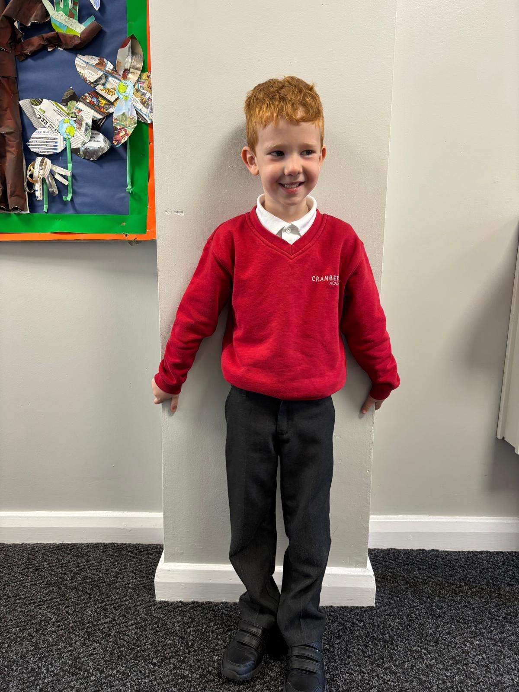
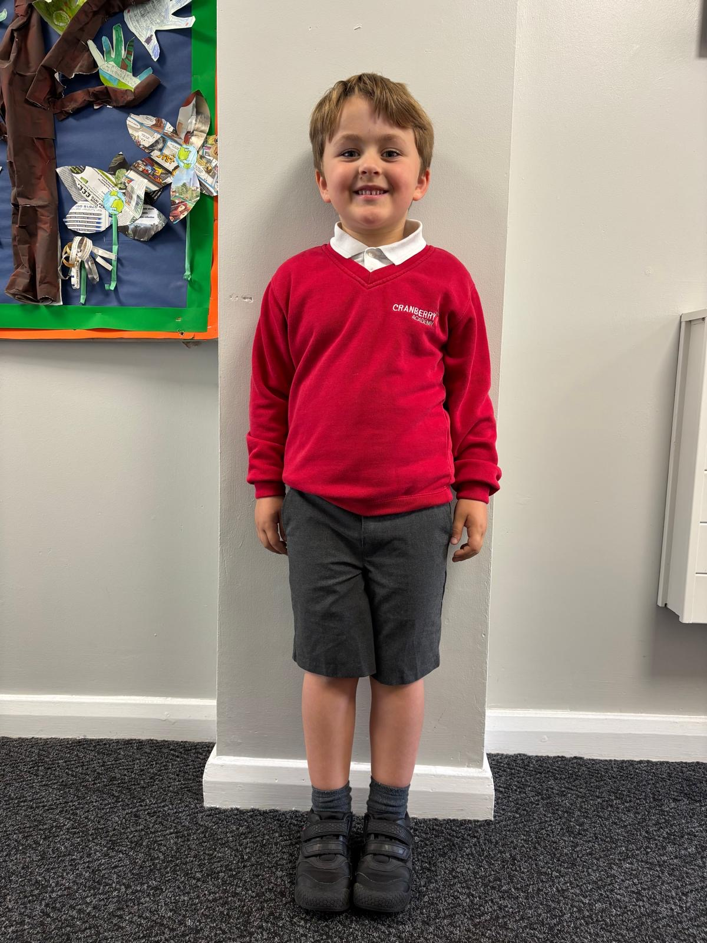
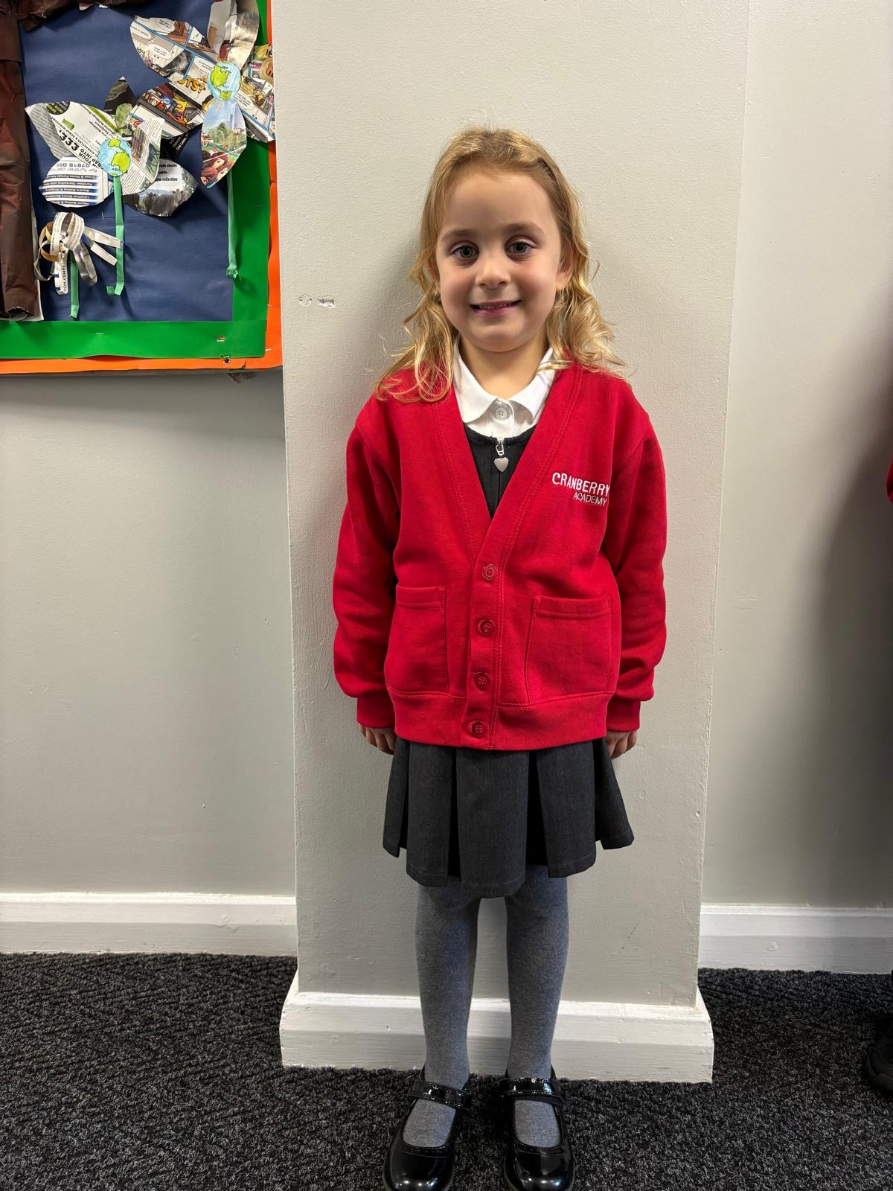
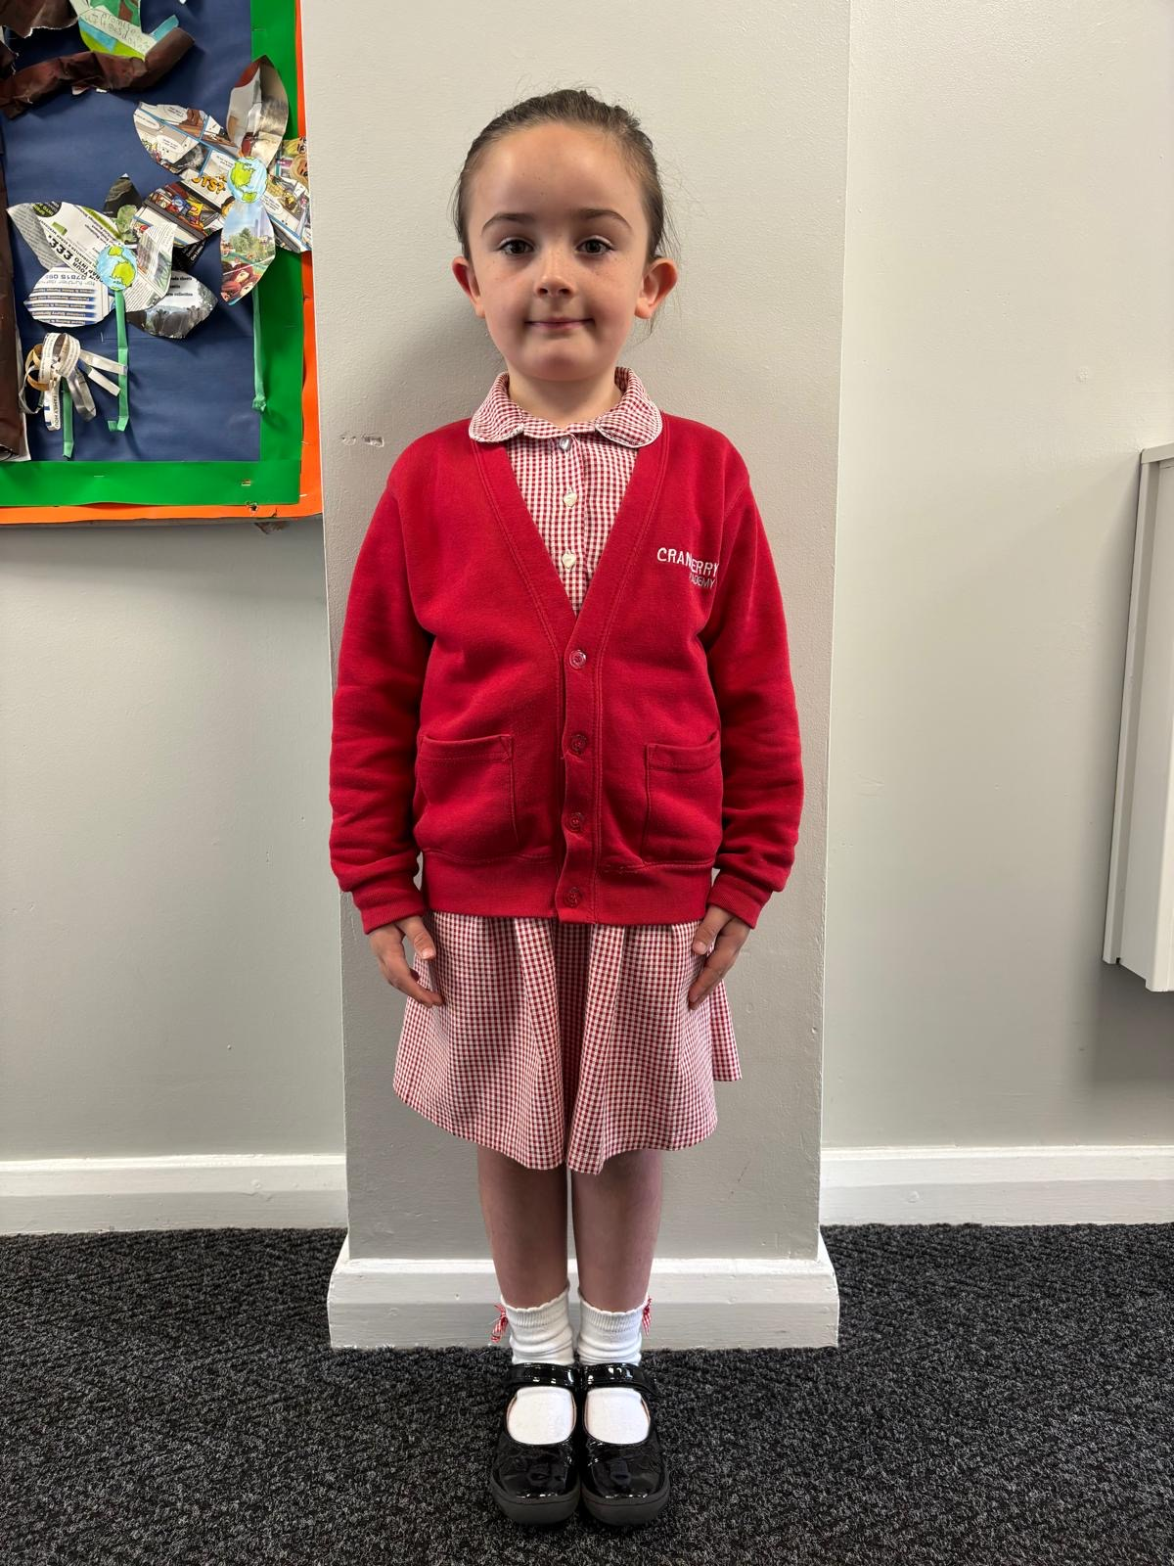
Uniform
Red logo jumper or cardigan
White collared T-shirt
Grey trousers/skirt/dress
- Grey or white socks
-Black school shoes with Velcro fastening if possible
Waterproof coat
Long haired tied up and no shaved lines in hair
- Earrings must only be small studs. No other jewellery allowed.
(Any children who want a place in reception need to re-apply before December 2025. Admission to Nursery does not guarantee that you will be offered a place in the reception class

Slide 7

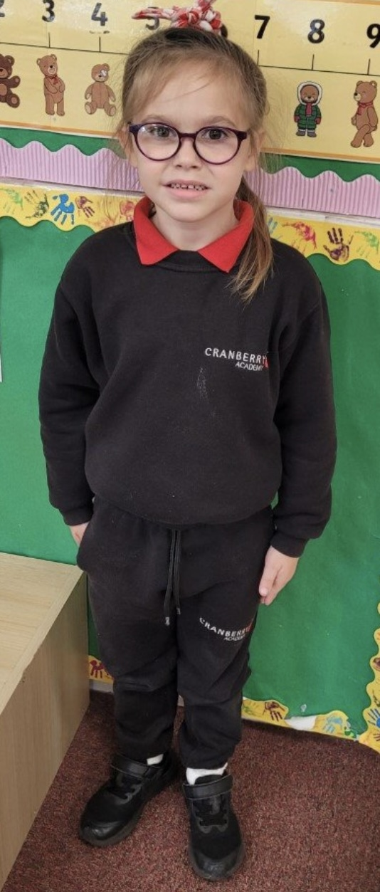
PE/Outdoor learning kit
black shorts/leggings/jogging bottoms
Red T-shirt
Black jumper
Black pumps with Velcro or black trainers
- Wellies (to be kept in school)
NO jewellery
Long haired tied up
(The school logo jumpers are not essential for this)
(Any children who want a place in reception need to re-apply before December 2025. Admission to Nursery does not guarantee that you will be offered a place in the reception class

Slide 8
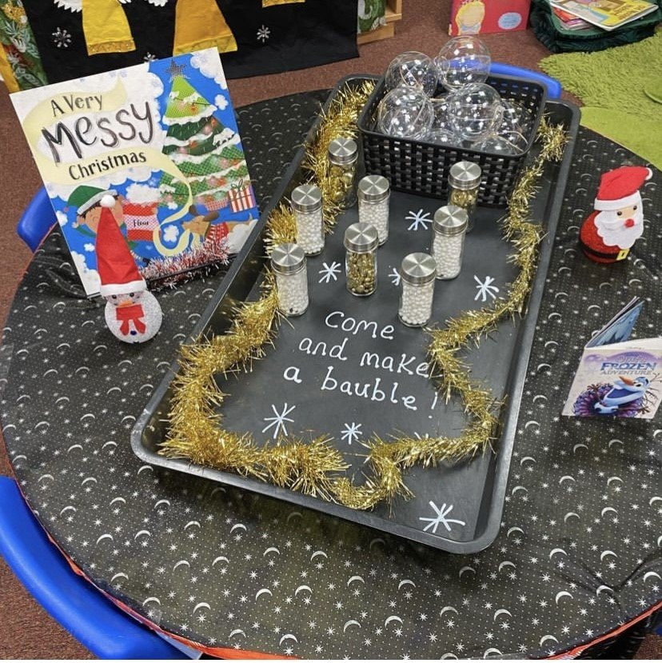
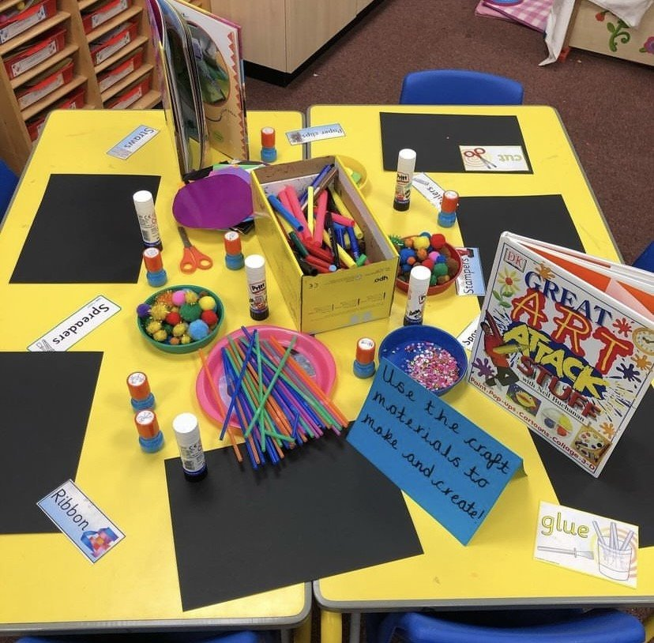
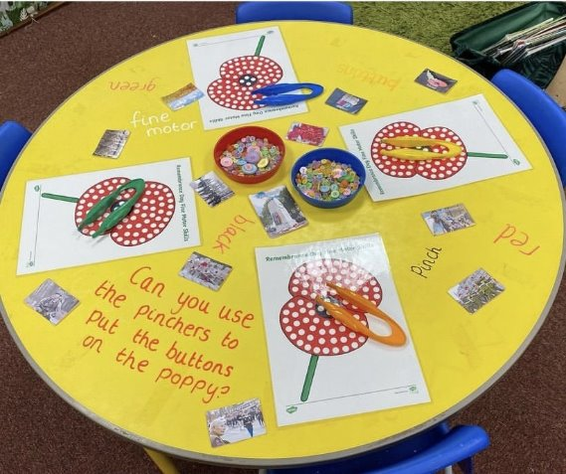
A typical day in Nursery
Daily Routine
Trips & Visitors
9:00 AM
9:00 AM
9:30 AM
11:30 AM
1:00 PM
1:30 PM
2:30 PM
3:00 PM
Doors open & self registration
Phonics
Free play & snack time
Lunch
Registration & maths/topic
Free play
Rhymes & story time
Home time
  During the year we organise trips and visitors to come into school to enhance the children’s learning experiences.

Slide 9
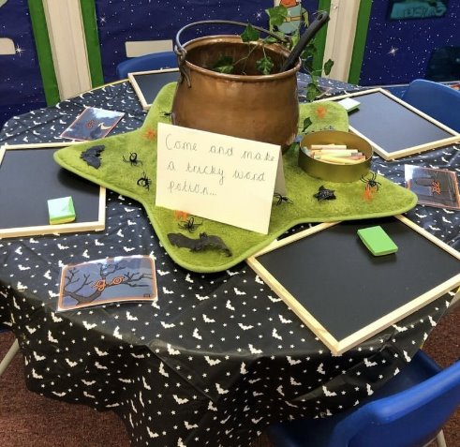
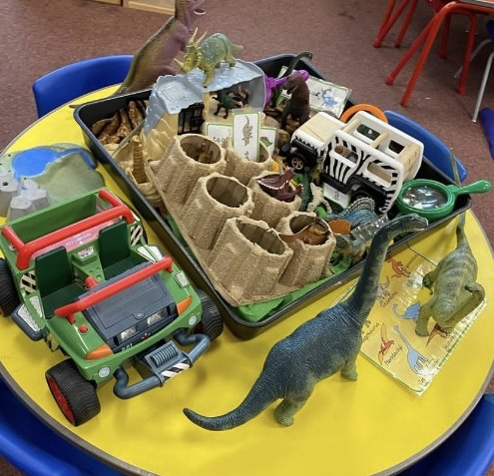
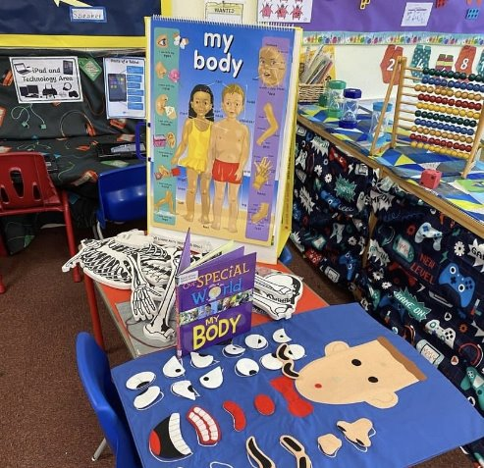

A typical day in Reception
Daily Routine
Trips & Visitors
8:45 AM
9:00 AM
9:30 AM
11:45 AM
1:00 PM
1:30 PM
2:30 PM
3:15
Registration
Wake up shake up & phonics
English/Maths input, free play & snack.
Lunch
Registration & wider curriculum
Free play
Group reading then story time
Home time
  During the year we organise trips and visitors to come into school to enhance the children’s learning experiences.

Slide 10
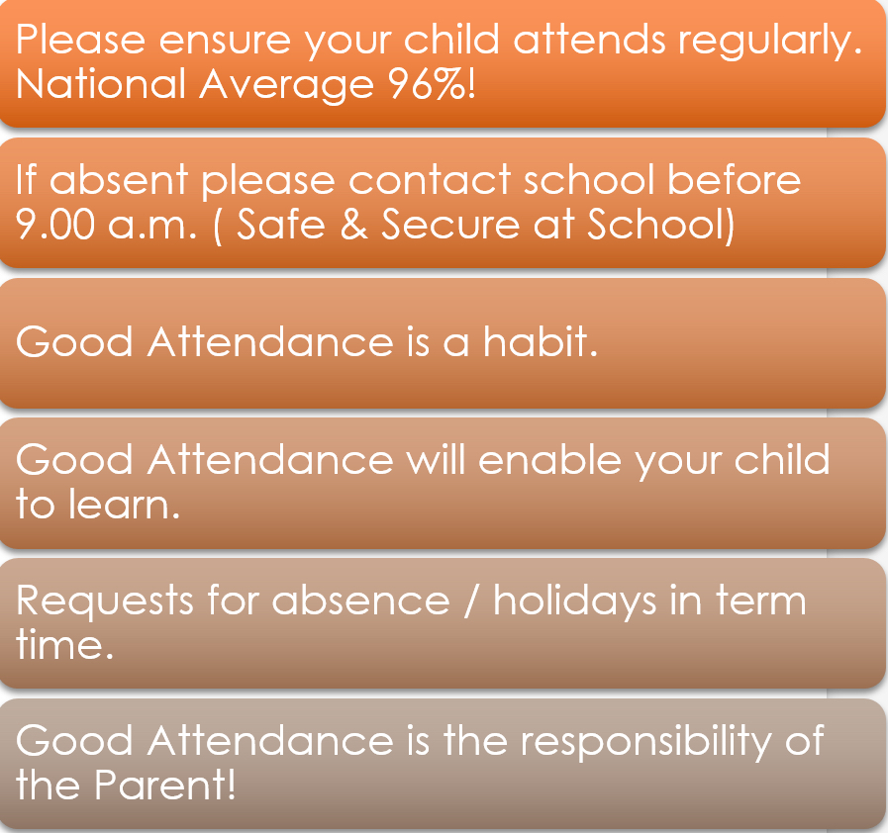
Attendance
Lateness
  Please speak to the office if your child is going to be late into school. You will need to report to the main office if you are late.
Whizz Kids
  Whizz kids runs from 7:30am until 6pm daily. This is a brilliant provision for parents to use on site.
  Charges apply

Slide 11
Free school meals!
You can claim free school meals for each child who attends school in Cheshire East if you receive one of the following benefits:
universal credit with no earned income or with net monthly earnings less than. £618.67
Income support
Income based Jobseeker’s Allowance
Income related Employment Support Allowance
Support under Part VI of the ‘Immigration and Asylum Act 1999
The guaranteed element of State Pension Credit
Child Tax Credit - as long as you have a yearly household income of less than £16,190 (as assessed by HM Revenue and customs) and do not get Working Tax Credit
Working Tax Credit run-on (paid for 4 weeks after you stop qualifying for Working tax Credits.

Slide 12
Nursery & Reception Lunch
Cost
Nursery and Reception children can choose to have a school dinner or a healthy packed lunch.
Nursery lunches cost £2.60 per day
Reception lunches are provided for free through the government scheme.
The Benefits
Socialisation
Table manners / encouraging children to use cutlery to eat their lunch
Introduce children to new tastes and foods
Children are learning to make healthy choices

Slide 13
Toilet Training & Dummies
Toilet Training
All children need to be toilet trained when they start nursery, unless they have a medical reason.
Any children that are not fully toilet trained will not be able to access full time provision.
Dummies
Dummies are not allowed in school and it is important that they are weaned off these before starting nursery.

Slide 14


Medicine in school
Medicines
Sickness
If your child has any medical conditions or you are worried about their health, please make us aware as soon as possible.
in addition, if your child needs an inhaler/epipen or any other medicine, please speak to us as soon as possible.
If your child is prescribed medicine, we are able to administer the medication but we ask you to go to the main office to fill out the necessary paperwork first and they will bring the medicine to them. Never put the medicine into your child’s school bag and send them in without speaking to an adult first.
- We are unable to administer unprescribed medication such as Calpol or Nurofen.
If your child is sick or has diarrhoea, they must stay at home for 48 hours after their last episode. Please refer to the schools sickness policy on the school website.

Slide 15
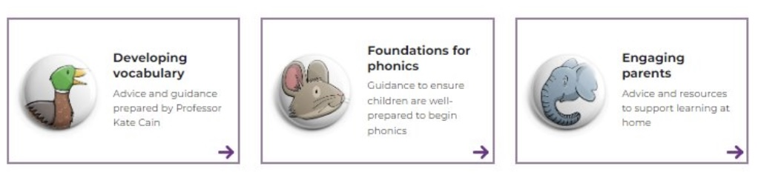
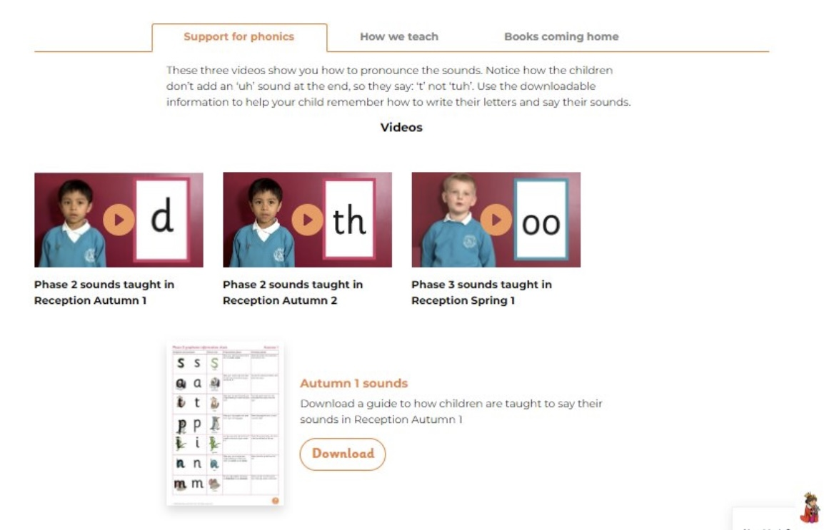
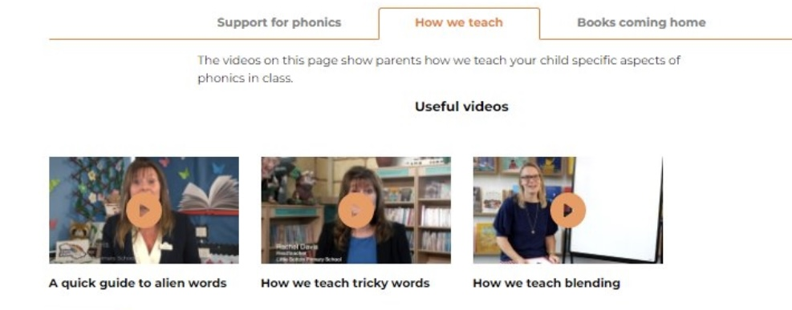
Phonics scheme!
At Cranberry, we follow the Little Wandle phonics scheme.

Slide 16
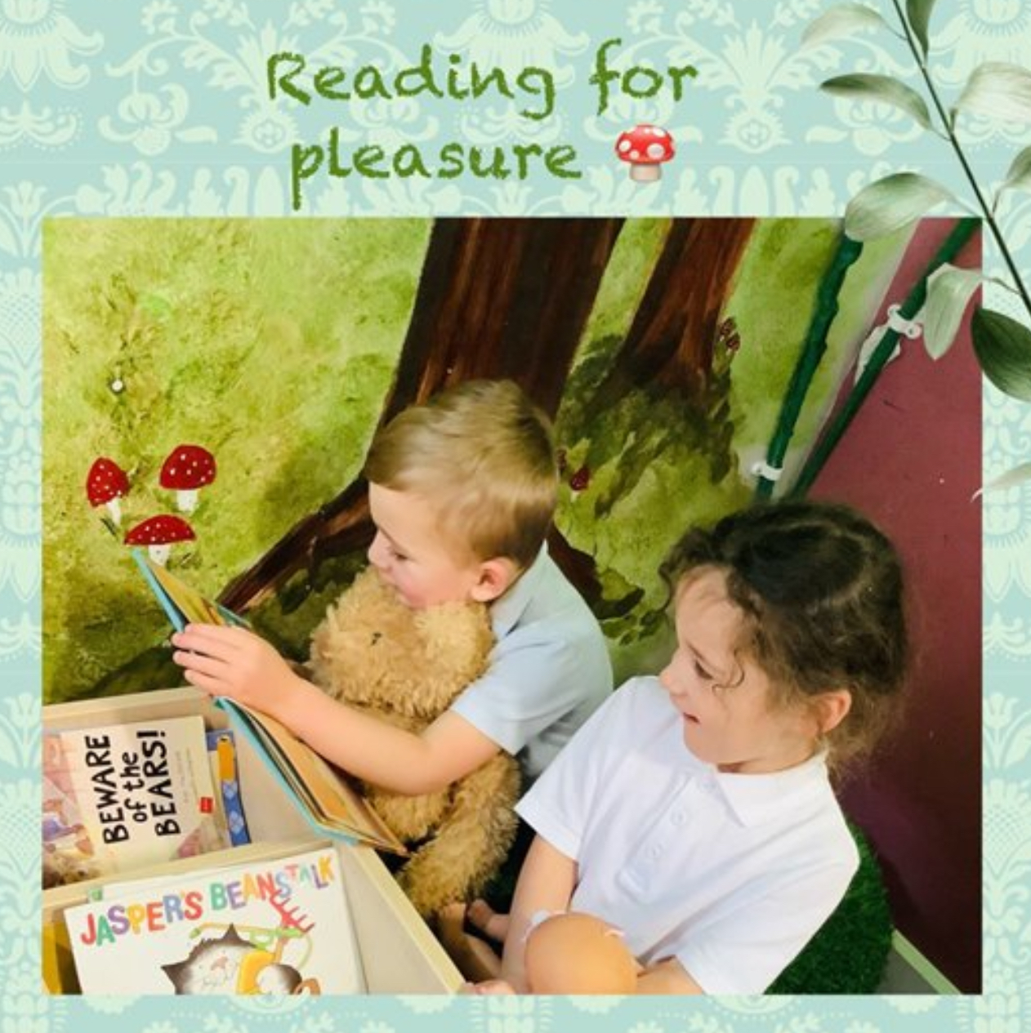


Reading
Please read with your child as much as possible.
We will send a phonics reading book home and the children have access to our library books to share with you at home.
All parents will be given a ‘book reader’ account. This is an online reading diary and we ask that you complete it every time you read at home.

Slide 17
September
Children in Reception will start on Tuesday 2nd September. They will attend full time unless there is a specific reason for not doing so.
Children who currently attend our Nursery, will return to school full time on Tuesday 2nd September.
Children new to Nursery who have not attended any other provision will start school on Tuesday 2nd September and will stay for the morning sessions for that week. This will be reviewed daily and any child who is ready will be able to stay for their full allocated hours the following week.
Children will come into both Nursery and Reception on their own, as we find the children settle a lot quicker this way.

Slide 18
September
Children attending our nursery full-time will start at 9am and finish at 3pm - Mon-fri
Children attending our nursery part-time will either do;
Monday & Tuesday 9am-3pm and Wednesday 9am-11:45am
Or;
Wednesday 11:45am-3pm, Thursday & Friday 9am-3pm
*Please note that on the change over day on the Wednesday your child will not have their lunch at school so will need lunch either when they get home or before coming into school.
Children attending our reception will start at 8:45am-3:15pm Mon-Fri.

Slide 19
Transition Days
Transition days for new nursery starters are:
Wednesday 2nd July 9:30-10:30am (parents/carer to stay)
Thursday 3rd July 9:30-10:30am (child to stay alone)
(Any nursery children who attend already and are moving into reception will just do their normal school day)
Transition days for new reception starters are:
Wednesday 2nd July 9:30-1:30pm
Thursday 3rd July 9:30-1:30pm
Children to bring their own packed lunch
(Children already in reception will do their normal school day)

Slide 20



Communication
Please note…
Information about how to access these will be sent out to you before the end of the school year.

Slide 21
Stalls
Please have a look at the stalls around the room.
Miquills - examples of menus and school lunches
School uniform providers
Whizz Kids

Slide 22


